Slide 1
Performance Analysis
CS121 Parallel Computing
Spring 2017

Slide 2
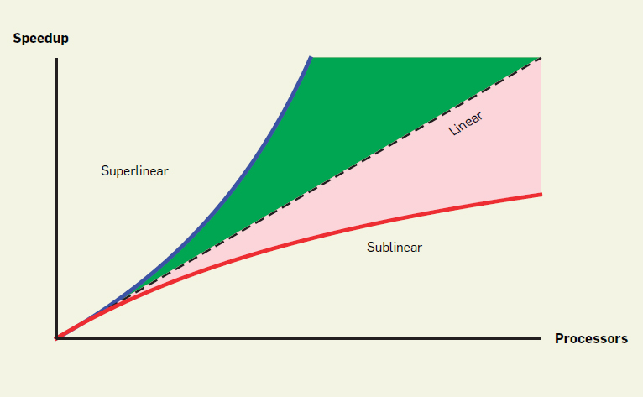
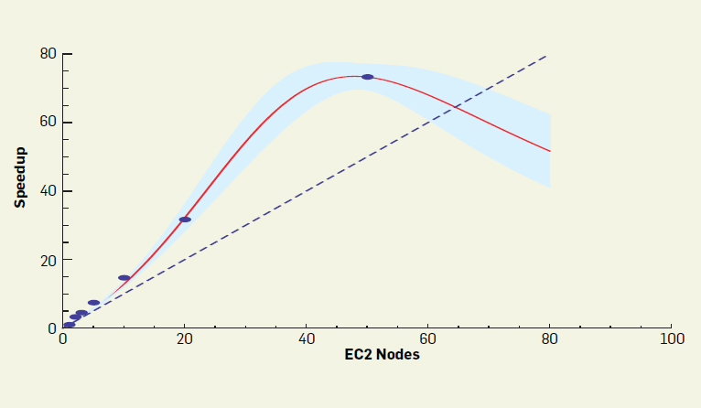
Parallel performance
Ideally, a program runs k times faster on k processors than on one.
Almost never achieved in practice. Why?
Goal Given a parallel program, understand its performance under increasing levels of parallelism.
Identify performance bottlenecks.
Compare different algorithms for a problem.
Try to abstract away machine details.
Find performance properties that hold regardless of architecture.
Use asymptotic analysis.

Slide 3
Speedup
For a given problem X and parallel algorithm A solving X, let
T_{s} = minimum time to solve X on one processor, i.e. the time for the best sequential algorithm.
T₁ = time algorithm A takes using one processor.
T₁ ≥ T_{s}.
T_{p} = time algorithm A takes using p processors.
Absolute speedup S*_{p} = T_{s} / T_{p}.
Compare A with the best sequential algorithm.
Relative speedup, aka scalability S_{p}= T₁ / T_{p}.
Compare A with itself on different machine sizes.
Focus on scalability, since hard to know what best sequential algorithm is.
Work W_{p} = p T_{p} = “total cycles burned” by p processors.
p T_{p} ≥ T_{s}, because parallel system has to do at least as much total work as the best sequential algorithm.
Efficiency E_{p} = S_{p} / p = speedup per processor.
Typically ≤ 1 due to overhead.
But can be > 1 in practice in special circumstances.

Slide 4
Overheads
Linear scalability S_{p}= p.
Hard to achieve due to overheads.
Communication and synchronization time between processors.
Processors can idle due to poor partitioning or load imbalance.
Sometimes cheaper for a processor to redo a computation than get the result from another processor. But this increases overall computation.
Sometimes the best sequential algorithm is not parallelizable.
Must choose more work intensive (higher W_{p}) but more parallelizable algorithm.
Ex Dijkstra’s shortest path algorithm does less work than Bellman-Ford, but BF is more parallelizable.

Slide 5
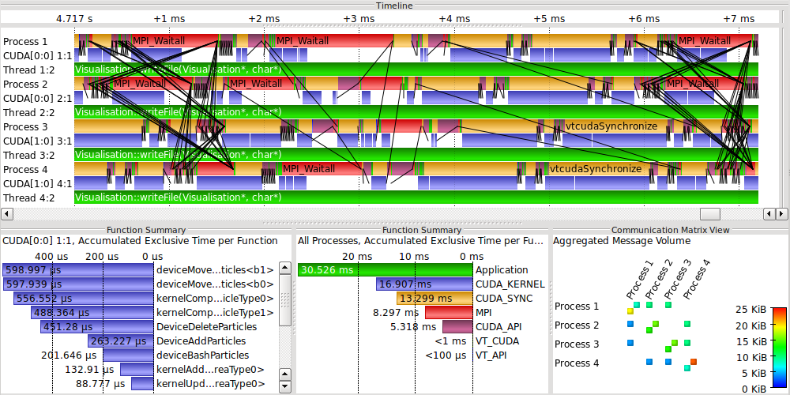
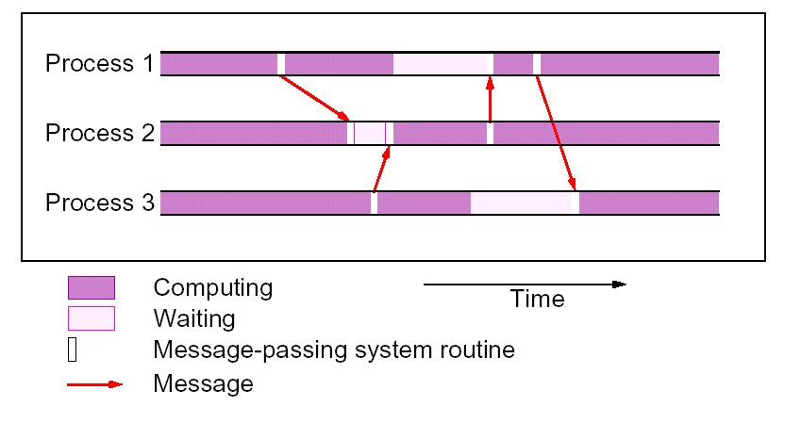
Execution profile

Slide 6
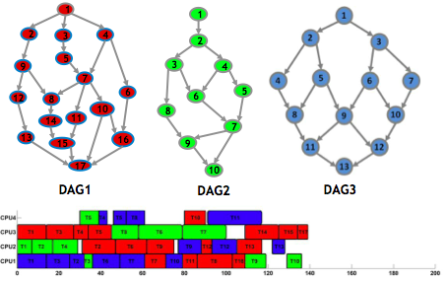
DAG model
Nodes represent computations / tasks.
Can be weighted to represent different task sizes.
Directed edges represent dependencies between tasks.
(u,v) indicates task u must finish before task v completes.
Can be weighted to indicate communication, startup cost etc. for task.
Assume default weight is 0.
Graph can’t contain cycles, i.e. computation must eventually finish.
Critical path is length of longest directed path in graph.

Slide 7
DAG model
Given a dag G, let
C = sum of node and edge weights in G.
D = length of critical path in G.
T_{p} = time taken by p processors to execute G.
T∞ = minimum time to execute G using arbitrary number of processors.
Assume p processors, each doing one unit of work per time step.
Work law p T_{p} ≥ C.
I.e. T_{p} ≥ C / p. Places lower bound on parallel running time.
Holds because processors must do all the work in G.
Span law T∞ ≥ D.
Due to dependency, tasks along critical path must be done sequentially, regardless of number of processors.

Slide 8
Amdahl’s Law
Another upper bound maximum speedup achievable of a program.
Let T₁ be time to run a program using one processor.
Assume f fraction of it the program is inherently sequential, i.e. cannot be parallelized.
f T₁ amount of work is sequential.
(1-f) T₁ amount of work is parallelizable.
On parallel computer with p processors
Sequential part still takes f T₁ time.
Parallel part takes (1-f) T₁ / p time.
Total time T_{p} = f T₁ + (1-f) T₁ / p.

Slide 9
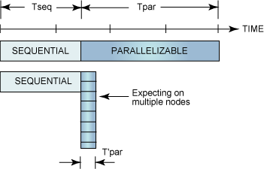
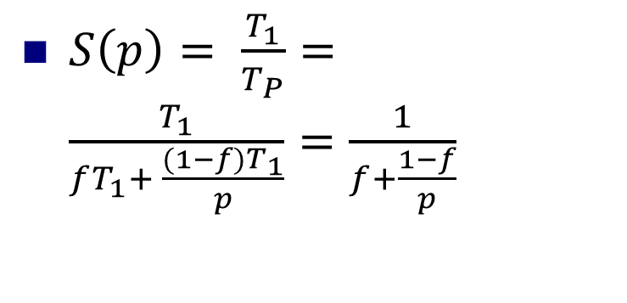
Amdahl’s Law
$S\left(p\right)= \frac{T_{1}}{T_{P}}=\frac{T_{1}}{fT_{1}+ \frac{(1−f)T_{1}}{p}}=\frac{1}{f+\frac{1−f}{p}}$
Source: https://www.ibm.com/ developerworks/library/l-cluster1/
As p increases, second term in denominator gets smaller, but first term always stays the same.
So S(p) < 1/f always.
Speedup never exceeds one divided by the fraction of sequential work.

Slide 10
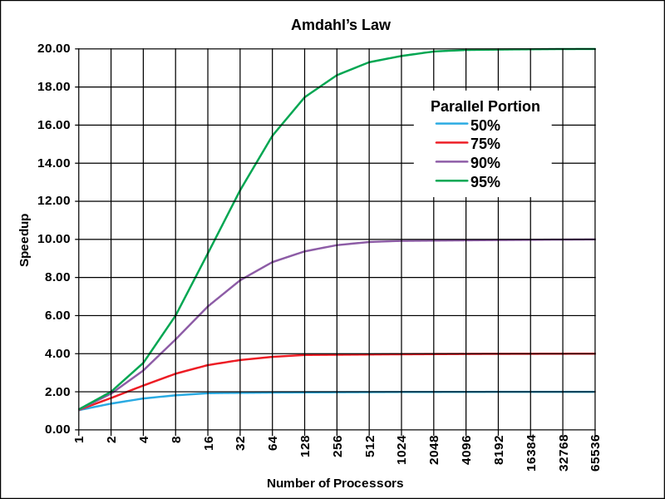
Amdahl’s Law
Even with a small proportion of sequential work, parallelism is very limited.
Suggests it’s pointless to build large computers with thousands of cores, since they can’t improve performance much.
But, in real world large scale parallelism is very useful. Why?
Source: Wikipedia

Slide 11
Gustafson’s Law
Gustafson’s law tries to explain why real parallel systems often get good speedup.
Amdahl’s Law assumes a fixed problem size, and looks at runtime as we increase parallelism.
But when parallelism increases, we often try to solve a larger (scaled) problem.
Ex Given few processors, we try to solve a coarse weather model. Given more processors, we try to solve a finer model.
Gustafson’s Law assumes size of scaled problem is chosen so the parallel running time stays the same as the running time of the original problem.
Gustafson’s Law also assumes the sequential work in the scaled and unscaled problems are the same.
Ex For weather prediction, sequential work may be initialization, which is roughly same in coarse and fine model.
This assumption may or may not be valid in practice.
The parallel work increases in the scaled problem.
Ex Parallel work (the actual weather simulation) increases in finer model.

Slide 12
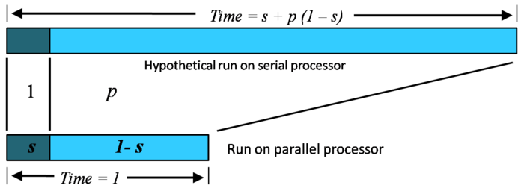
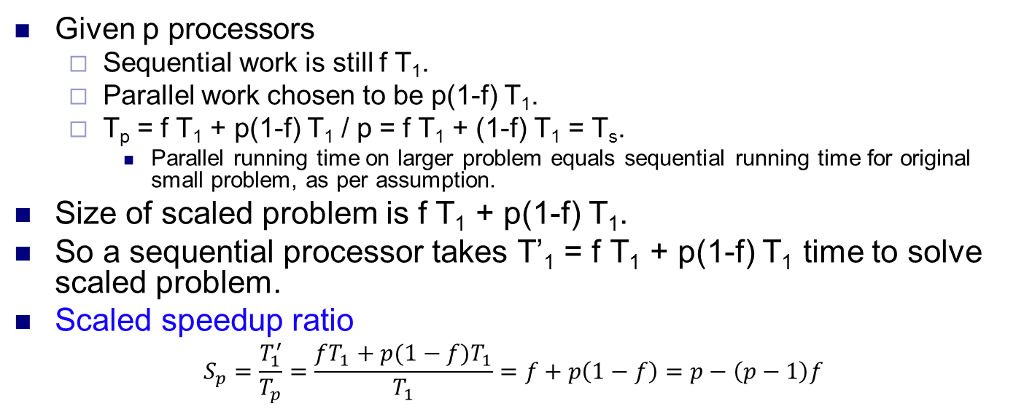
Gustafson’s Law
Given p processors
Sequential work is still f T₁.
Parallel work chosen to be p(1-f) T₁.
T_{p} = f T₁ + p(1-f) T₁ / p = f T₁ + (1-f) T₁ = T_{s}.
Parallel running time on larger problem equals sequential running time for original small problem, as per assumption.
Size of scaled problem is f T₁ + p(1-f) T₁.
So a sequential processor takes T’₁ = f T₁ + p(1-f) T₁ time to solve scaled problem.
Scaled speedup ratio
$$S_{p}=\frac{T_{1}^{′}}{T_{p}}=\frac{fT_{1}+p(1−f)T_{1}}{T_{1}}=f+p\left(1−f\right)=p−\left(p−1\right)f$$
Source: http://wiki.expertiza.ncsu.edu/ index.php/CSC/ECE_506_Spring_2012/4b_rs

Slide 13
Comparison and limitations
Gustafson’s Law predicts much better speedup than Amdahl’s Law.
Ex For f = 0.05, p = 50.
Amdahl’s Law gives speedup = 1 / (0.05+.95/50) = 14.5
Gustafson’s Law gives speedup = 50-49*0.05 = 47.6
Amdahl’s Law also called strong scaling, i.e. performance improvement for fixed problem size and increasing processors.
Gustafson’s Law also called weak scaling, i.e. performance improvement for fixed problem size per processor.
Which assumption is more appropriate for given problem determines which law applicable.
Important shortcoming of Amdahl’s and Gustafson’s Laws is they ignore overhead as parallelism increases.

Slide 14
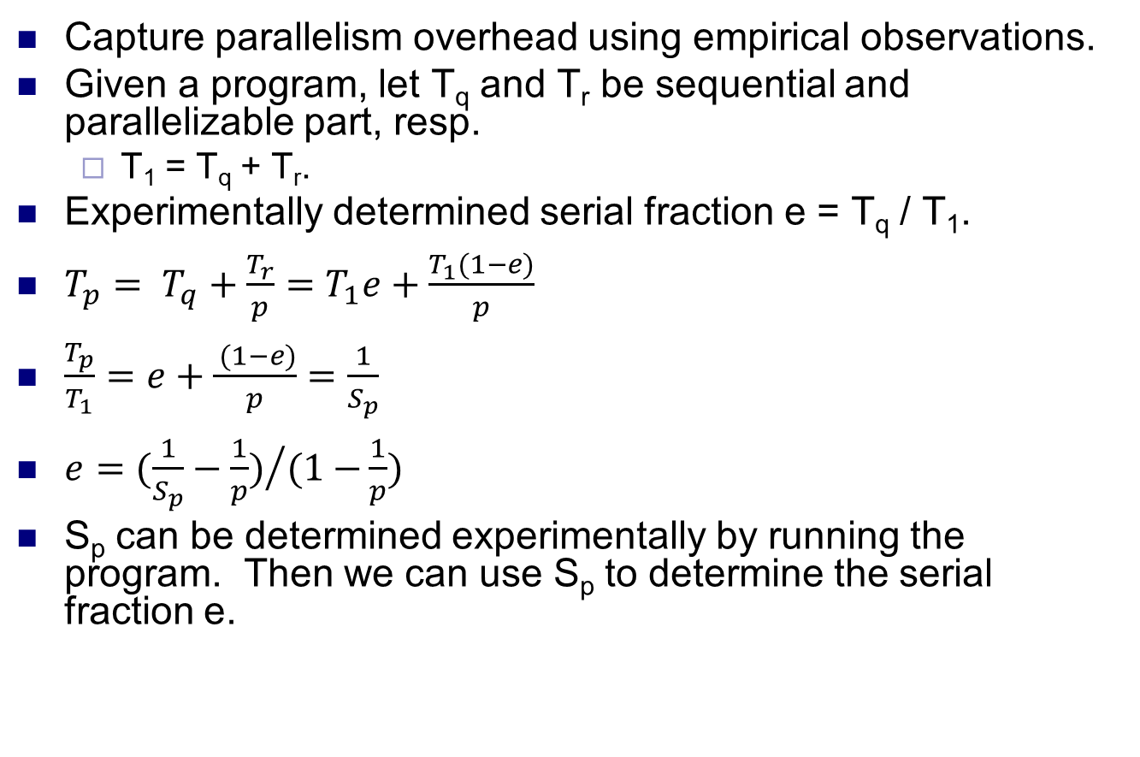
Karp-Flatt metric
Capture parallelism overhead using empirical observations.
Given a program, let T_{q} and T_{r} be sequential and parallelizable part, resp.
T₁ = T_{q} + T_{r}.
Experimentally determined serial fraction e = T_{q} / T₁.
$T_{p}= T_{q}+\frac{T_{r}}{p}=T_{1}e+\frac{T_{1}(1−e)}{p}$
$\frac{T_{p}}{T_{1}}=e+\frac{ (1−e)}{p}=\frac{1}{S_{p}}$
$e={(\frac{1}{S_{p}}−\frac{1}{p})}/{(1−}\frac{1}{p})$
S_{p} can be determined experimentally by running the program. Then we can use S_{p} to determine the serial fraction e.

Slide 15
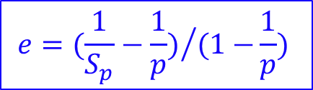
Karp-Flatt metric
$$e={(\frac{1}{S_{p}}−\frac{1}{p})}/{(1−}\frac{1}{p})$$
Suppose observed speedups for a program are
Since e increases with p, this says overhead is increasing with parallelism.
Since e is constant with p, overhead does not increase.
p | 2 | 3 | 4 | 5 | 6 | 7 | 8
S_{p} | 1.87 | 2.61 | 3.23 | 3.73 | 4.14 | 4.46 | 4.71
e | 0.07 | 0.75 | 0.08 | 0.085 | 0.09 | 0.095 | 0.1
Source: https://www3.nd.edu/~zxu2/ACMS40212-S15.html
p | 2 | 3 | 4 | 5 | 6 | 7 | 8
S_{p} | 1.82 | 2.50 | 3.08 | 3.57 | 4.00 | 4.38 | 4.71
e | 0.1 | 0.1 | 0.1 | 0.1 | 0.1 | 0.1 | 0.1

Slide 16
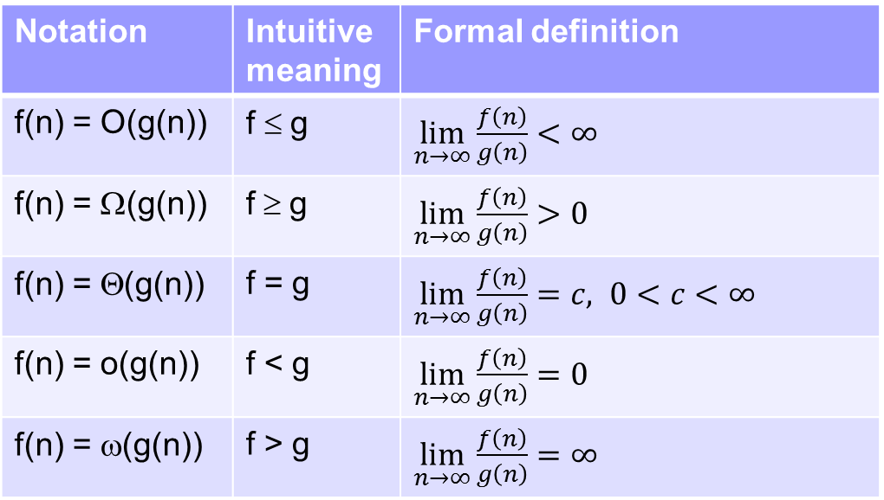
Asymptotic complexity
Compare trends in the sizes of two functions.
Given functions f(n) and g(n), there are 5 comparison operators.
Analogous to the 5 comparison operators for numbers.
Notation | Analogy | Formal definition
f(n) = O(g(n)) | f ≤ g
f(n) = Ω(g(n)) | f ≥ g
f(n) = Θ(g(n)) | f = g
f(n) = o(g(n)) | f < g
f(n) = ω(g(n)) | f > g

Slide 17
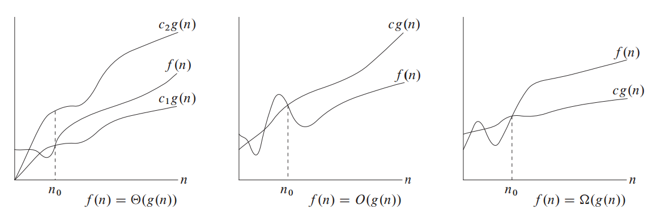
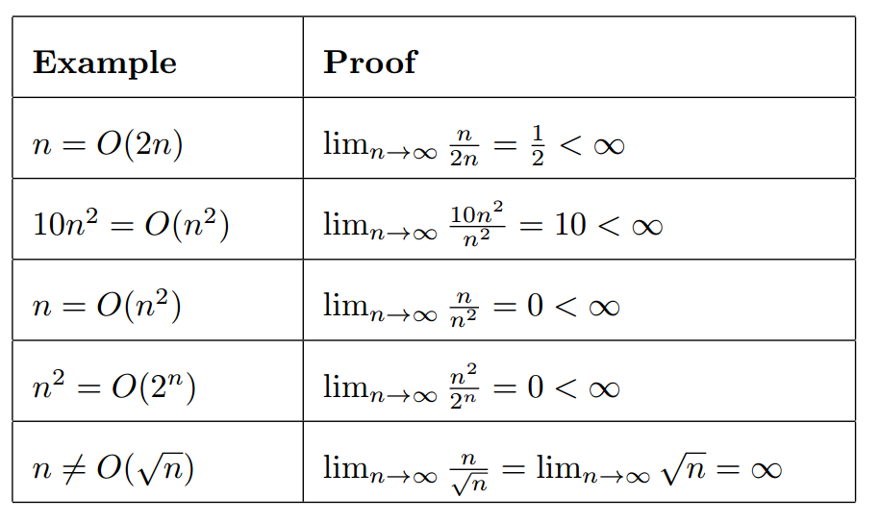
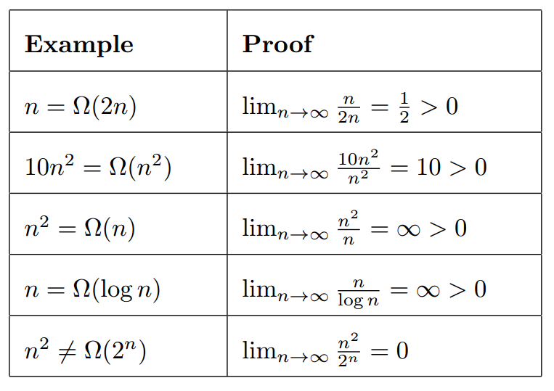
Examples
Source: Introduction to Algorithms, Cormen et al

Slide 18
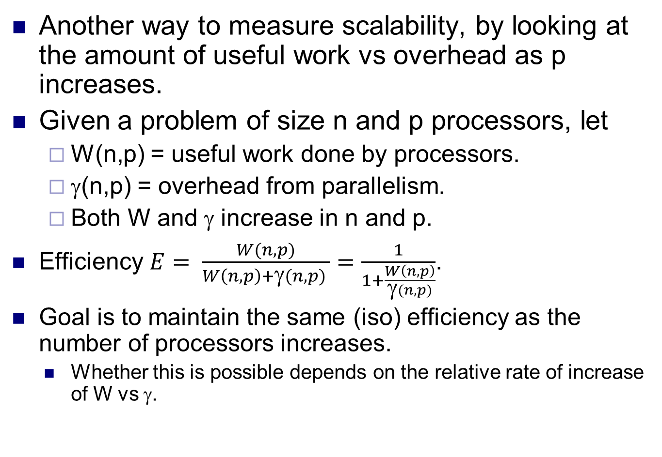
Isoefficiency
Another way to measure scalability, by looking at the amount of useful work vs overhead as p increases.
Given a problem of size n and p processors, let
W(n,p) = useful work done by processors.
γ(n,p) = overhead from parallelism.
Both W and γ increase in n and p.
Efficiency $E= \frac{W(n,p)}{W\left(n,p\right)+\text{g}(n,p) }=\frac{1}{1+\frac{W\left(n,p\right)}{\text{g}(n,p)}}$.
Goal is to maintain the same (iso) efficiency as the number of processors increases.
Whether this is possible depends on the relative rate of increase of W vs γ.

Slide 19
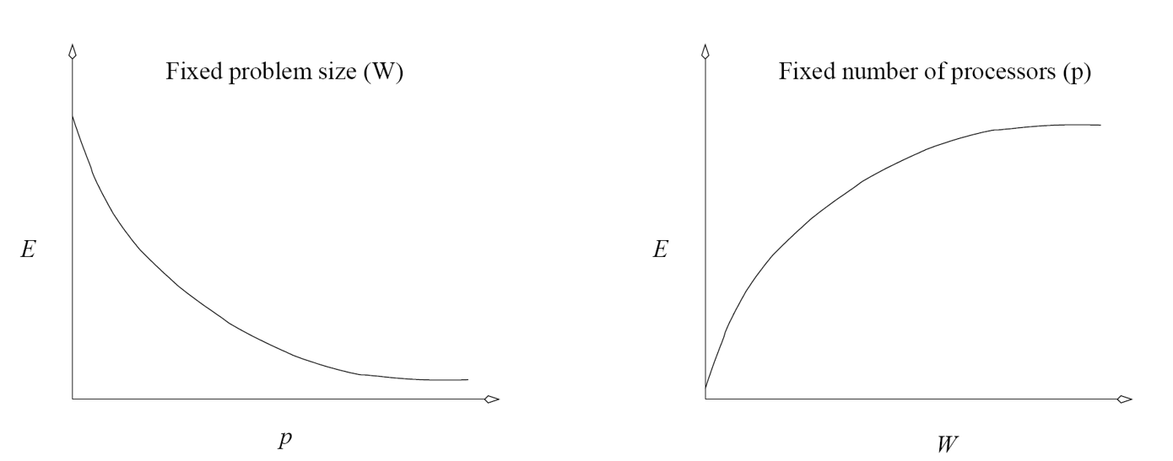
Work vs overhead
As p increases but n stays constant, γ typically increases faster than W.
Efficiency decreases for constant problem size and increasing number of processors.
As n increases but p stays constant, W typically increases faster than γ.
Efficiency increases for constant number of processors and increasing problem size.
Thus, can use increase in problem size to balance increase in processor count to maintain efficiency, i.e. achieve isoefficiency.

Slide 20
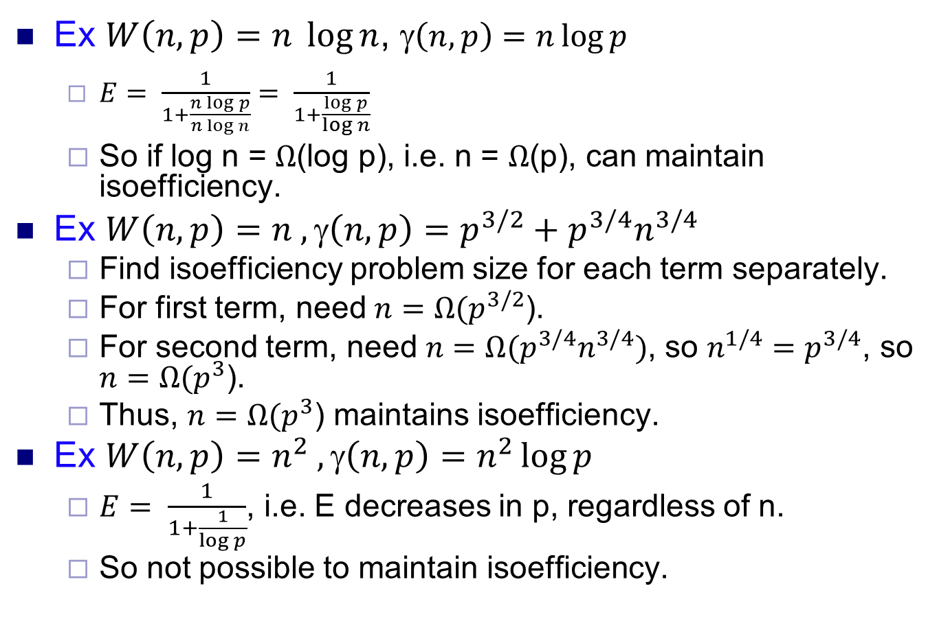
Examples
Ex $W\left(n,p\right)=n \log{n}$, γ$\left(n,p\right)=n\log{p}$
$E= \frac{1}{1+\frac{n\log{p}}{n\log{n}}}= \frac{1}{1+\frac{\log{p}}{\log{n}}}$
So if log n = $Ω$(log p), i.e. n = $Ω$(p), can maintain isoefficiency.
Ex $W\left(n,p\right)=n ,\text{g}\left(n,p\right)=p^{3/2}+p^{3/4}n^{3/4}$
Find isoefficiency problem size for each term separately.
For first term, need$n=Ω(p^{3/2}$).
For second term, need ${n=Ω(p}^{3/4}n^{3/4})$, so $n^{1/4}{=p}^{3/4}$, so $n=Ω(p^{3}$).
Thus, $n=Ω(p^{3}$) maintains isoefficiency.
Ex $W\left(n,p\right)=n^{2} ,\text{g}\left(n,p\right)=n^{2}\log{p}$
$E= \frac{1}{1+\frac{1}{\log{p}}}$, i.e. E decreases in p, regardless of n.
So not possible to maintain isoefficiency.

